Slide 1


Day 2: MS Office Applications
PARIWARTAN COMPUTER TRAINING INSTITUTE
ISO Certified 9001-2015 | Authorized By: GCSA & DCE
Hands-on with MS Word, Excel & PowerPoint
Document Creation, Data Management & Presentation Skills

Slide 2

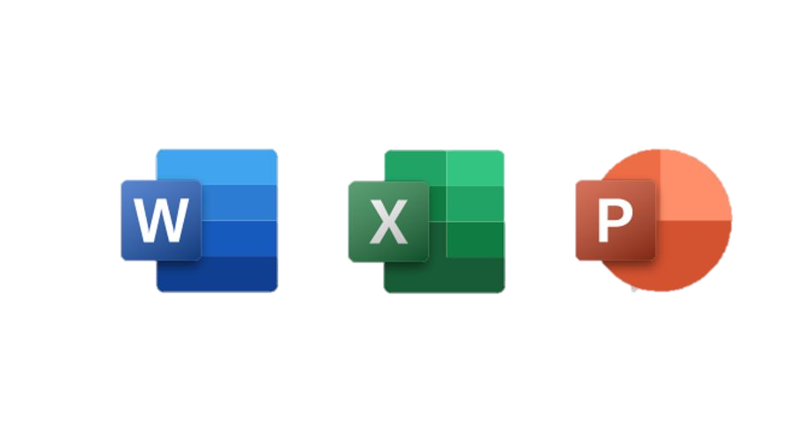
Overview – What is MS Office?
- A suite of productivity tools by Microsoft.
- Common applications:
• MS Word – for documents
• MS Excel – for data
• MS PowerPoint – for presentations
- Used in schools, offices, businesses, and homes.

Slide 3

MS Word – Document Creation
- Typing and editing text
- Formatting: bold, italics, font size, alignment
- Bullets, numbering, margins, spacing
- Insert: table, image, shapes, header/footer
Task: Create a personal profile with formatting and image.

Slide 4



MS Excel – Data Management
- Worksheets, rows, columns, cells
- Data entry and formatting
- Basic formulas: SUM, AVERAGE, IF
- Charts and conditional formatting
- Task: Create a marksheet, calculate total & average, insert a pie chart.

Slide 5

MS PowerPoint – Presentations
- Slides with text, images, SmartArt
- Design themes, transitions, animations
- Slide show view
🔧 Task: Create a 3-slide presentation titled 'My Hobbies' with transitions.
Notes:
- Desktop, Laptop, Tablet
- Smartphone, Server, Supercomputer

Slide 6

Activity & Homework
🔹 Class Activity:
- Create formatted Word bio-data
- Excel sheet for daily expenses
- PPT on 'My Hobbies'
🔹 Homework:
1. Word: 'My Computer Workshop Journal – Day 2'
2. Excel: July monthly expenses
3. PPT: 'Importance of Computers'
4. Purpose of Word, Excel, PowerPoint
5. List all items under 'Insert' tab in Word.

Slide 7

Q&A + Recap
What is the purpose of MS Excel, and give one real-life use case.
Write the formula to calculate the total of cells B2 to B6 in MS Excel.
How can you make text bold and italic in MS Word?
Name two objects you can insert in a PowerPoint slide.
Match the application with its use: MS Word, Excel, PowerPoint
Shortcut :
Start a slideshow → ______
Save a file → ______
Copy text → ______
Notes:
2: 4th Gen
3: WINRAR, Antivirus, Backup Software, Disk Cleanup Tools,

Slide 8


